Slide 1
CSS Bootcamp
Fast and Furious
What you should already know…

Slide 2
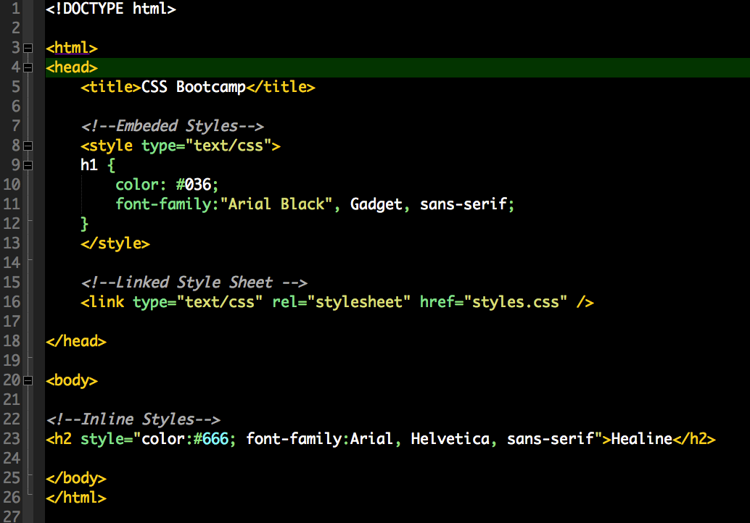
Proximity
Inline, Embedded and External Styles
Takes from closes to farther.

Slide 3
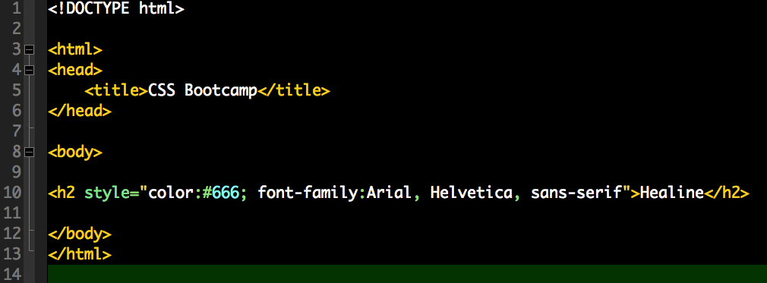
Inline

Slide 4
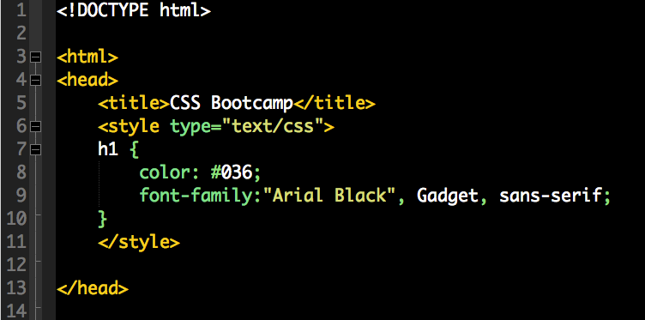
Embedded in Head Tag

Slide 5
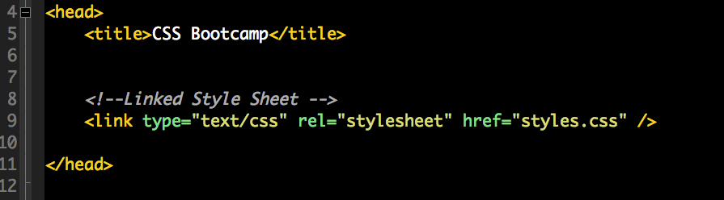
External Link (ideal, preferred)

Slide 6
Cascade
Think of dropping the element in at the top and as it moves down, each rule gets its chance to make changes.
Browser
HTML
BODY
PARENT DIV
TAG

Slide 7
Inheritance
Think Big and get specific
Everything in inherited by default.
Simplifies the amount of code but can be hard to figure out.

Slide 8
CSS Selectors
Specifically selectors specify the part of our page we want to apply properties to. Like a stencil, as the movie mentioned.
The part in HTML, typically the <div>s and tags.
Type, ID and Classes

Slide 9
Type
Type selectors are the simplest selector. They refer directly to an HTML tag
In HTML <h1> <h2> <p> <ul> <li> etc.
In CSS h1, h2, p, ul, li (no . needed)

Slide 10
ID Selector
For a Single Element. USE ONLY ONE TIME
Used for structure like footer
In HTML: <div id=“footer”></div>
In CSS: #footer{}

Slide 11
Class Selector
Use multiple times
Style anything, most common usage in CSS
In HTML: <div class=“myClass”></div>
In CSS: .myClass{}

Slide 12
Class Attributes
In HTML can combine or apply a class to a Type
Helpful and powerfull
<p class=“myClass”></p>

Slide 13
Compound Selectors
In the CSS we can build on other selectors
p.intro{}
.myClass .subclass{}

Slide 14
Pseudo Class Selectors
Mostly used for links
a:link{}
a:visited{}
Other pseudo elements are hover (mouse over), active (when clicked) and focus (when the element has keyboard focus.)

Slide 15
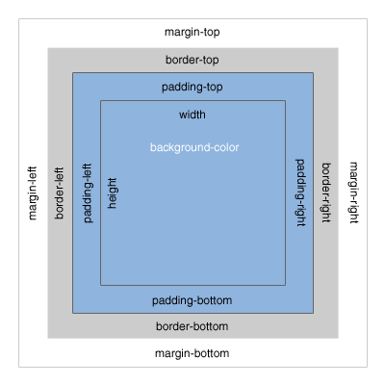
Box Model (Margin, Padding, Border)
Width/height > padding > border > margin

Slide 16
Padding
Spacing between elements inside the box

Slide 17
Margin
Spacing between elements outside or around the box.

Slide 18
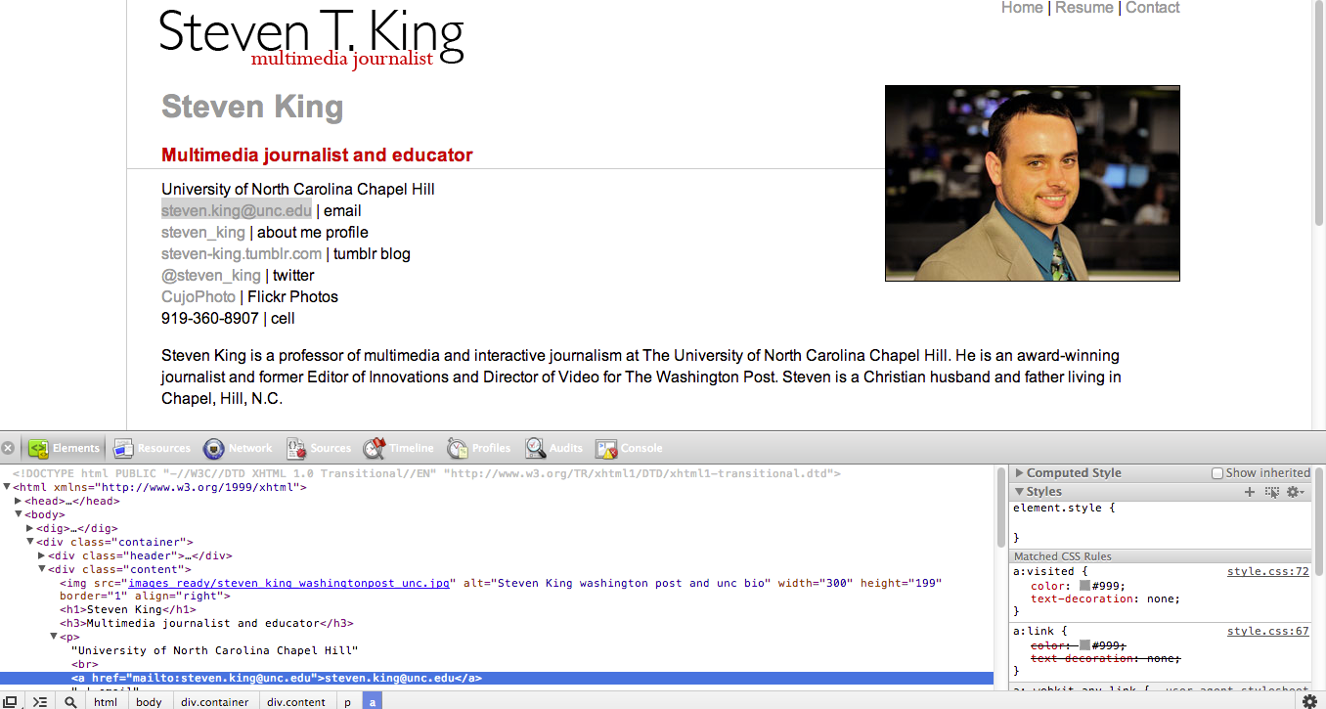
Tools: Inspect Element

Slide 19

Responsive Design: Twitter Bootstrap
http://twitter.github.com/bootstrap/

Slide 20
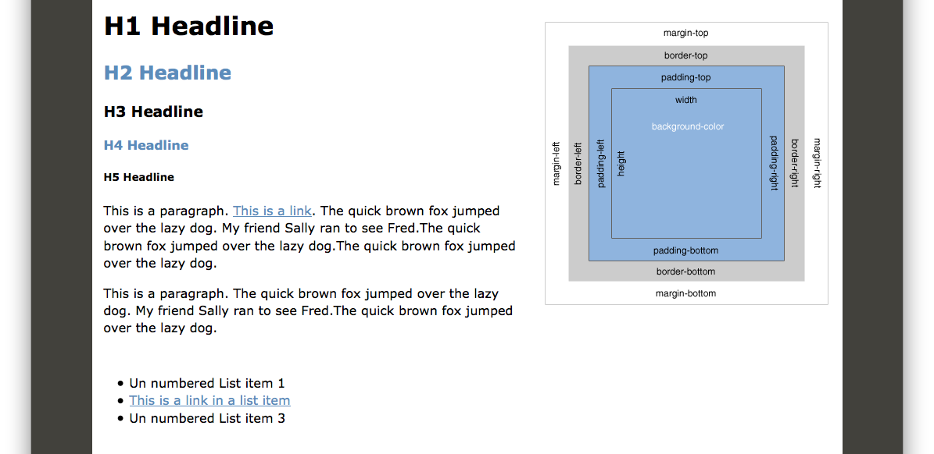
Assignment
Using the html file provided, create the CSS to make this page.
Submit via Lore

